Slide 1




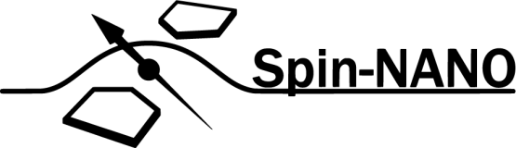
A Multi-Node Quantum Network with Defects in Diamond
Ph.D. Proposal - Matteo Pompili

Slide 2


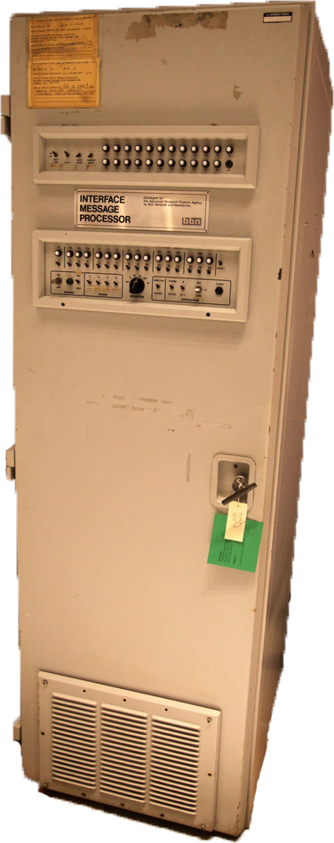
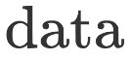
What is a (Quantum) Network?

Slide 3
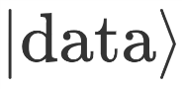
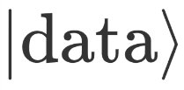
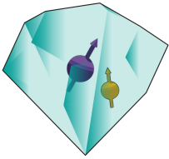

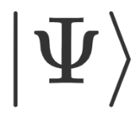
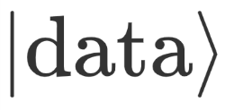

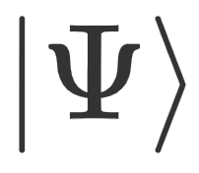

What is a (Quantum) Network?

Slide 4




What is a (Quantum) Network?
Known applications:
Quantum Key Distribution (QKD)
Blind quantum computation
Distributed quantum computation
Clock Synchronization
Leader election
…

Slide 5
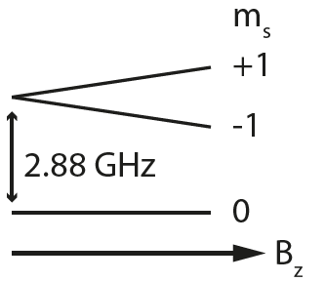
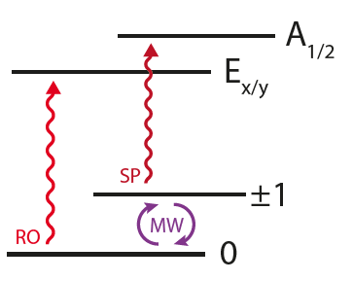
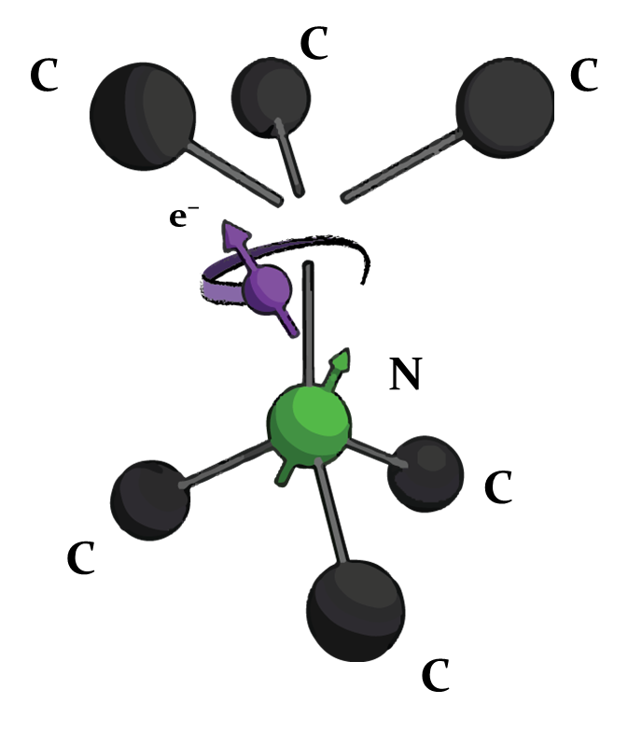

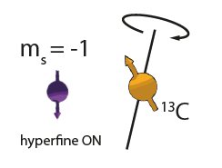
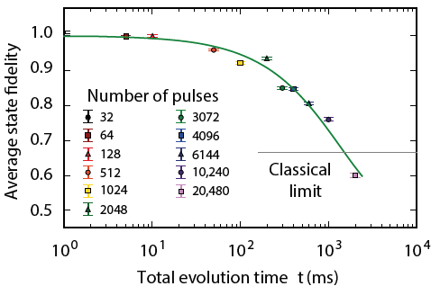
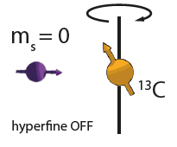
The Nitrogen Vacancy Centre in Diamond
C¹³
M. H. Abobeih et al. Nature Comm. 2018.
C¹³

Slide 6
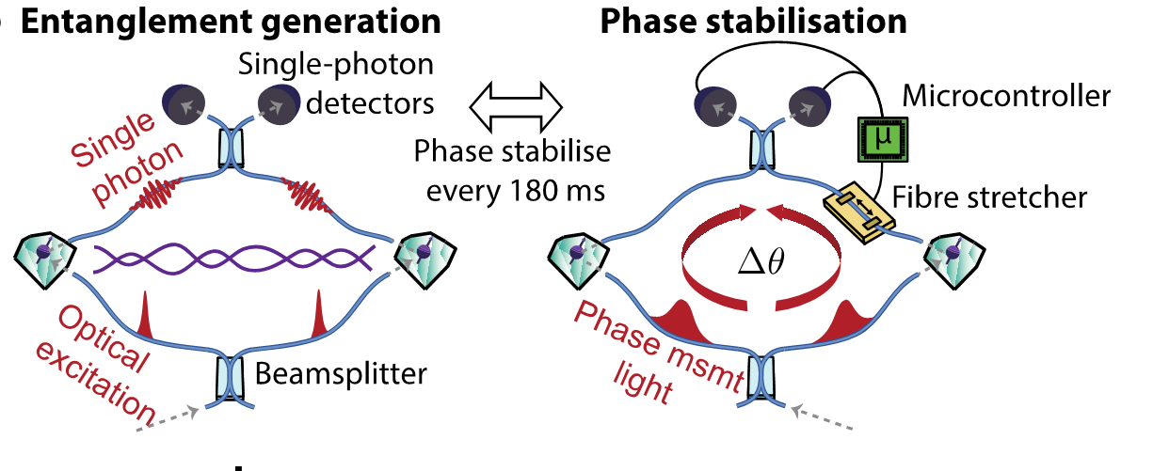
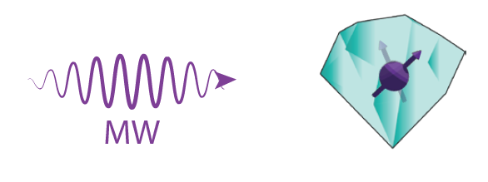
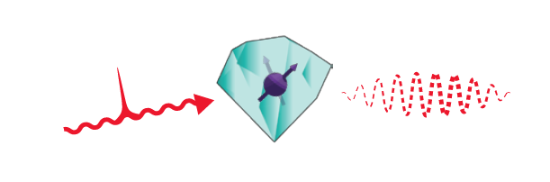
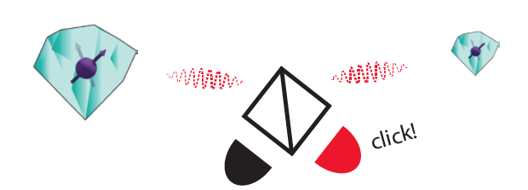
Single Click Entanglement
P C Humphreys et al., Nature 558, 268–273 (2018)

Slide 7
Research goals
Demonstration of quantum applications on a multi-node network
Generation of genuine multipartite entangled states,
Proof of principle demonstration of the Link layer of the future Quantum Internet stack,
Teleportation of entanglement in a four node network,
Client-Server secure delegation of quantum computation.

Slide 8
Genuine Multipartite Entanglement

Slide 9
Link Layer Demonstration

Slide 10
Teleportation of Entanglement

Slide 11
Client-Server Secure Delegation

Slide 12
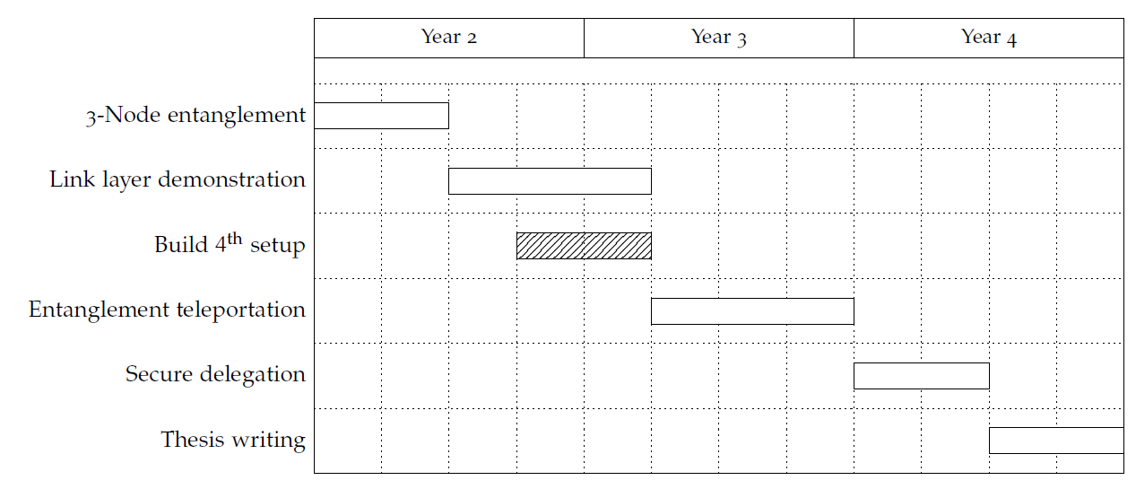
Proposed Ph.D. Timeline

